Slide 1


Unit 1 Friendship
Warming up & Pre-reading

Slide 2
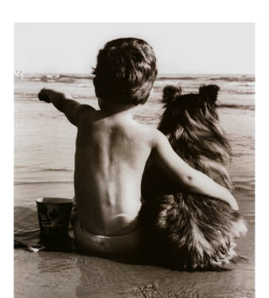
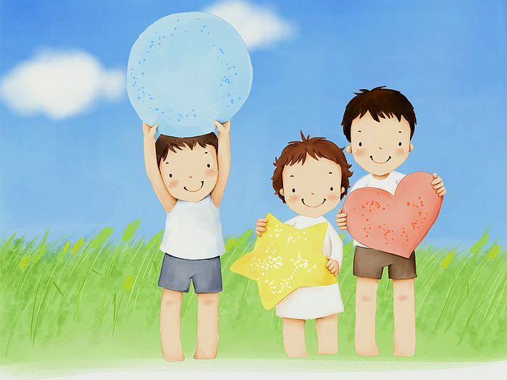
C | O | F | R | I | E | N | D | R | T
F | R | I | E | N | D

Slide 3
What is friendship?
When it rains, I think friendship
is a small It can give
me a piece of clear sky.
When I’m crying, I think friendship
is a white It can
wipe my tears dry.
umbrella.
handkerchief.

Slide 4
Do you have friends? What kind of
friend do you like?(adj.)
kind
brave
honest
helpful
friends
generous
humorous
hard-working
clever

Slide 5
Group task: Brainstorming
What qualities should a good friend have?
honest, friendly, helpful, kind, brave, open-minded, patient, careful, full of love, caring, interesting, selfless, intelligent…

Slide 6
What do you do to be a good friend?
Do the survey on page 1. Add up your score according to the scoring sheet after the survey. You don’t have to tell your results, you can keep it a secret.

Slide 7
Scoring sheet for the survey
1 A 1 B 3 C 2 2 A 1 B 2 C 3 3 A 1 B 2 C 3 4 A 3 B 2 C 1 5 A 0 B 3 C 0

Slide 8

Results
4-7 points: You are not a good friend.
You either neglect your friend’s
needs or just do whatever he/she
wants you to do without thinking
whether the behaviour is right or
not. You should think about what a
good friend needs to do and say to
his/her friend.

Slide 9

8-12 points: You are a good friend but
you sometimes let your friendship
become too important, or you fail to
show enough concern for your
friend’s needs and feelings. Try to
strike a balance between your friend’s
needs and your own responsibilities．

Slide 10
13+ points: You are an excellent
friend who recognizes that to be a
good friend, you need to balance
your needs and your friend’s
needs. Well done!
To have a good friend, you need to be a good friend.

Slide 11
Proverbs about friendship:
1. A friend in need is a friend indeed.
2. A real friend is one who walks in when the rest of the world walks out.
3. Friends care; Friends share; We need friends everywhere!

Slide 12
4.A life without a friend is a life without the sun.
5.True friendship is like sound health; the value of it is seldom known until it is lost.

Slide 13
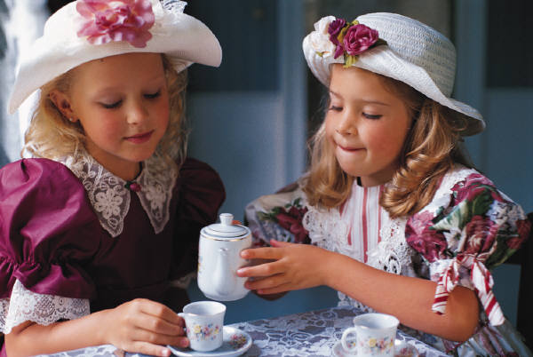
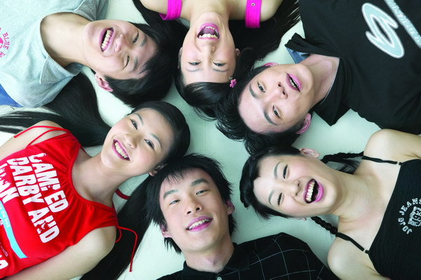
Talk
Does a friend always have to be a
person? What else can be your
friend? Tell us about your unusual
friends.

Slide 14
True friendship can exist between any two souls, be it between people or animals.
It can happen at any moment, to anyone. Even to lifeless things, like a diary, a ball, a friendship can happen.

Slide 15
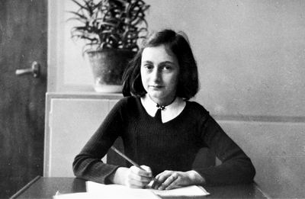
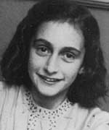
Do you know her name?
Anne Frank

Slide 16
Background Information
Anne Frank was born on June 12,1929 in Frankfurt, Germany. At that time the Jewish people were an important part of the city’s economic and cultural success. Her father, Otto Frank , was a respected businessman whose family had lived in the city for many generations.

Slide 17
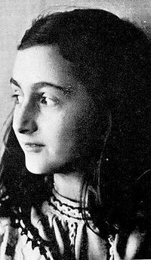
When Margot, Anne’s older sister died in March, 1945, Anne probably lost her desire to live. She died just before her 16th birthday and less than a month before the surviving Jews were liberated(解放).

Slide 18
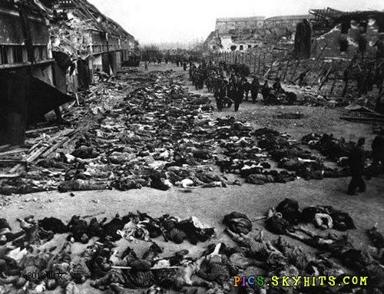
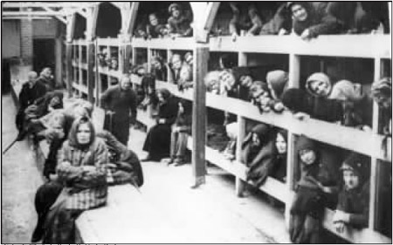
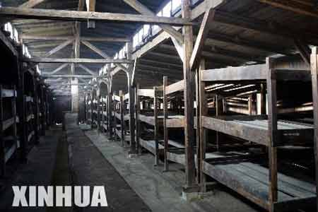
concentration camp

Slide 19



Slide 20
佳句
1.状语从句的省略:
_______(遛狗的时候), you were careless and it got loose and was hit by a car.
2.before引导时间状语从句,意为“到……之前”
She and her family hid away for nearly twenty-five months__________(他们才被发现).

Slide 21
3. 强调句型:It is/was+被强调部分+that/who…
I wonder if______because I haven't been able to be outdoors for so long___________(我变得对……无比狂热) everything to do with nature.
4.固定句型: 有一段……时期
I can well remember that__________(有一段……时期) a deep blue sky, the song of the birds…
5.句型:It was the first time that…是…第一次做某事。
…it was the first time in a year and a half that _____________(我目睹夜晚) face to face…

Slide 22

句型透视
1 While walking the dog，you were careless and it got loose and was hit by a car.
句型公式
“连词+v.-ing/v.-ed/adj.”式的省略结构
[温馨提示] 在“连词＋v.­ing/v.­ed”结构中，如果主语与动词之间是主谓关系，即用“连词＋v.­ing”形式；如果主语与动词之间是动宾关系，即用“连词＋v.­ed”形式。

Slide 23
【活学活用】
(1)While _______(travel) in Europe,he found many interesting things and experienced different cultures.
(2)He is a man of few words. He never speaks unless __________(speak) to.
(3)When_________ (take) according to the instructions, the drug has the least side effects.

Slide 24
2.She and her family hid away for nearly twenty-five months before they were discovered.
句型: “时间段+before”/
“It is/will be+时间段+before…”意为"过了多长时间后才..."。如:
Scientists say it may be five or six years before it is possible to test this medicine on human patients.

Slide 25
3 I wonder if it's because I haven't been able to be outdoors for so long that I've grown so crazy about everything to do with nature.
句型公式: 强调句
It is/was+被强调部分+that/who+句子其他成分

Slide 26
[温馨提示]
(1)强调句型中的主谓一致现象:强调主语时,that/who后的谓语动词必须与被强调的主语在人称和数上保持一致。如:
It's your efforts not your intelligence that determine your success.
(determine与your efforts保持一致)
(2)强调句型的判断方法:将it is/was和that/who同时去掉,看剩下的部分是否仍然是一个完整的句子。

Slide 27
用before，since，that填空。
1.How pleased I am tonight! It's years ________ we had so great a time together.
2.I think it won't be long ________ they understand each other.
3. It is two hours ______she spends on English every day.
4. It was two years _____he came back from abroad.
5.It is two years _______he came back from abroad.
6. It was after he got what he had desired ________ he realized it was not so important.

Slide 28
4 …it was the first time in a year and a half that I'd seen the night face to face…
句型公式
It is/was the first (second…) time that sb have/has done/had done…这是某人第几次做某事。
【相关拓展】
(1)It is (high/about) time that…是该做某事的时候了。(从句用一般过去时或“should+动词原形”)
(2)It is time (for sb) to do sth. 是该做某事的时候了。
(3)There was a time when…一度/曾经……

Slide 29
语法填空。
①It seems like high time that we ___________________ (look) seriously at the problem and the pressure it brings us.
②It is the second time that you ____________(fail) in the experiment.It is time that you reflected upon your mistakes.
③There was a time___________New York City buildings were almost all the same height.
④I guess it is time ________ (rush) out to Nanjing Road to sweep the stores for the last-minute discount.

Slide 30
1. add vt./vi. 增加，添加
Add up your score and see how many points you get.
(1) add up sth.= add sth. up 把…加起来
e.g.Add up your score.
e.g. Add up five and five and you’ll get ten.
(2) add up to sth. 总计为… （无被动语态）
e.g. His whole school education adds up to only one year.

Slide 31
1. add vt./vi. 增加，添加
(3) add to sth. 增添某物（多抽象名词）
e.g. His illness adds to the family’s trouble.
(4) add sth. to sth. 给…加上…
e.g. Will you add more sugar to the coffee?
(5) sb. add that… 某人补充说…

Slide 32
1. add vt./vi. 增加，添加
E.X.
1. The time I spend in commuting every day _________ two and a half hours.
2. Colorful balloons can _______ the festival atmosphere.
3. To make sure the result was correct, she _________ the figures again and again.
4. Please _____ something ___ what I have said.
adds up to
add to
added up
add
to

Slide 33
Your friend comes to school very upset.
2. upset vt./adj.
vt. (upset, upset) 使不安, 使心烦
e.g. 他的所作所为使他父母很不高兴。
What he had done _________________
e.g. 第一次数学测验的成绩可能会使部分同学很不安。
The result of the first math test may
______________________
upset his parents much.
upset some students.

Slide 34
2. upset vt./adj.
(2) adj. 心烦意乱的，不适的，不舒服的
【不作前置定语】
e.g. 我因为考试不及格很心烦。
I was really upset because I failed in the exam.
e.g. 是什么让她如此心烦意乱？
What made her so upset?

Slide 35
ignore the bell and go somewhere quiet to calm your friend down
3. ignore vt. 忽视，不理睬，不顾
e.g. 忽视交通信号灯是很危险的。
It is dangerous to__________________
e.g. 她看见他走来却忽视他。
She saw him coming but she ignored him.
ignore the traffic lights.

Slide 36
拓展
ignorance n. 无知，愚昧
ignorant adj. 无知的，不知道的
be ignorant of/about sb./sth.
不知道某人某事
e.g. She was ignorant of farm life.

Slide 37
4. calm vt. /vi./adj.
vt./vi. （使）平静，（使）镇定
vt. calm sb.(down)
e.g.Try deep breathing to calm your nerves (down).
e.g. 他尝试让自己冷静下来。
He tried to calm himself (down).
vi. calm down
e.g. The sea calmed down after the storm.

Slide 38
4. calm vt. /vi./adj.
(2) adj. 平静的，镇定的
e.g. calm weather/water
e.g. 即使很危险，但他保持镇静。
Although it was dangerous, _______________
he remained/stayed calm.

Slide 39
Tell your friend that you are concerned about him/her.
5. concern vt. /n.
vt. 使担心
sth. concern sb.
sb. be concerned about sth.
= sb. be worried about sth.
It concerns sb. that…
as far as sb. be concerned = in one’s opinion
在某人看来
某事让某人担心
某人关心/担心某事

Slide 40
5. concern vt. /n.
vt. 关心，使担心
e.g. 他关心他妈妈的健康。
He is concerned about his mother’s health.
=His mother’s health concerns him.
e.g. It concerns me that he is missing.
他的失踪令我担心。
e.g. As far as I am concerned, the price of oil will continue to increase.
在我看来，石油的价格还会继续上涨

Slide 41
5. concern vt. /n.
(2) vt. 涉及，与…有关＝involve，about
concern sth. = be concerned with sth.
concern oneself with 参与，干涉
与…有关的

Slide 42
5. concern vt. /n.
(2) vt. 涉及，关系到，参与
e.g. The meeting was concerned ____ reforms and everyone present was concerned______ their own interests.
= The meeting concerned reforms….
e.g. 你没有必要干涉发生了什么。
You don’t need to concern yourself with what happened.
with
about

Slide 43
5. concern vt. /n.
(3) n. 关心，关注
show concern about/for…
担心（关心）…
e.g. 他关心他的同桌。
He __________________ his deskmate.
shows concern about/for

Slide 44
…asks you to help him/her cheat in the exam by looking at your paper.
6. cheat vt./vi. 欺骗; 骗取; 作弊
cheat sb. ( out ) of sth. 骗取某人的某物
cheat sb. into doing … 骗某人做…
e.g. It was foolish of him ___________ ___________. (被骗了钱)
e.g. He was cheated ___________.（吸烟）
e.g. It is wrong _______________________.
（考试作弊）
to be cheated
of his money
into smoking
to cheat in the exam

Slide 45
tell him/her that he/she should have studied…
7. should have done 本来应该做某事 (而实际没做, 含有责备的意味)
should not have done 本来不该做某事(而实际已做)
e.g. He looks upset.
I__________________________________ .
(本不该告诉他这个坏消息）
e.g. You are late. You_________________
______________. (本该早五分钟来）
shouldn’t have told him the bad news
should have come five
minutes earlier

Slide 46
Sentence 1
…but your friend can’t go until he finishes cleaning his bicycle.
I didn’t realize how right my parents were until I entered high school.
His musical talent was not fully recognized until he died in 1750.

Slide 47
If you don’t understand something, you may research, study, and talk to other people until you figure it out. (live, wait, study, work)
He waited until all the luggage was cleared.
Until you told me I knew nothing about the mistakes I made in my exam.
Not until he retired from teaching three years ago did he consider having a holiday abroad.

Slide 48
Sentence 1
He broke it and you had to pay to get it repaired.
Your hair is too long now and you had better get it cut.
I got my leg broken while playing football.
He got his head caught in the door.

Slide 49
Sentence 2
Your friend comes to school very upset.
The plane has landed safely at the airport.
The bomb has been safely disposed of.
He returned from the war, safe and sound.
He arrived at the mountain village, cold, hungry and tired out.

Slide 50
Sentence 3
While walking the dog, you were careless and it got loose and was hit by a car.
连词+现在分词（过去分词） 做状语
when, while, unless, if, as if…
Don’t listen to music while (you are) doing your homework.
While ( I was ) waiting for the train, I was reading a daily newspaper.

Slide 51
The palace looked splendid when first (it was) built
If (we are) given more time, we can do it better.
Unless (you are) invited to speak, you had better keep silent.

Slide 52

Thank you.

